Slide 1
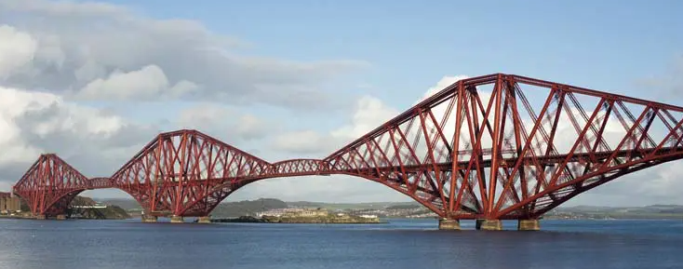
Bridge Over Incident Waters
SOC
Triage alerts, perform initial troubleshooting, analysis and escalate to IR.
IR
Respond to escalations, investigate, research, contain, and repel attacks.
Forensics
Perform deep analysis of an incident, creating a timeline of events and – where appropriate, suggest possible conclusions.
Forensics
IR
SOC
T

Slide 2
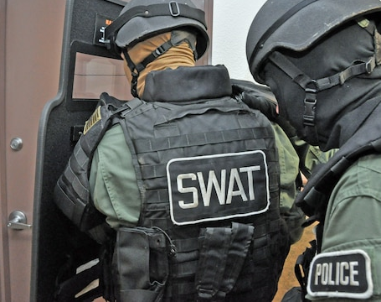
IR
Incident Response
The coordinated effort to respond to, thwart or repel an attack. It is all about preventing a compromise or at least reducing the blast radius.
T
This Photo by Unknown Author is licensed under CC BY

Slide 3
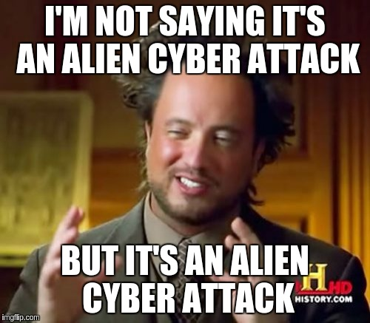
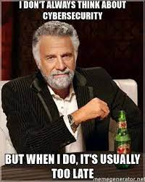
A day in the life of an Incident

